Slide 1
Restoration Advisory Board Meeting
September 11, 2019

Slide 2
Agenda
Introductions and May Meeting Minutes
Conceptual Model Refresher
June Soil Gas Sampling
Richmond Middle School August Sampling
Norwich Groundwater Sampling
Feasibility Study Report Status
Upcoming Work

Slide 3
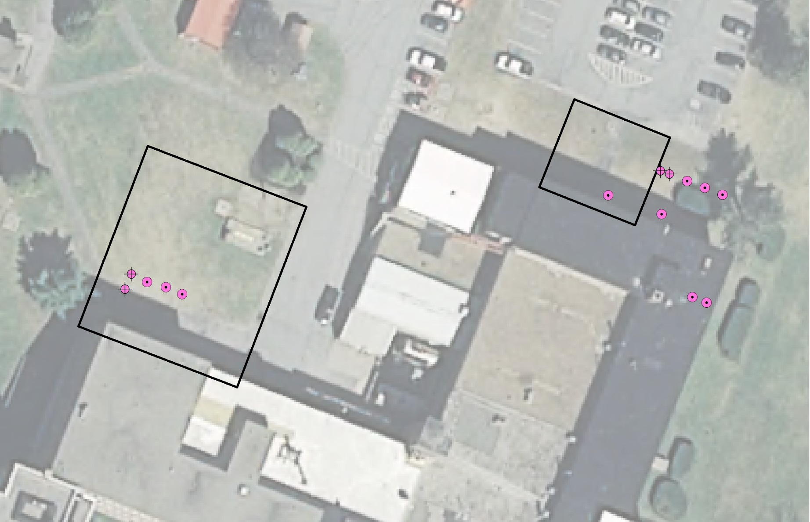
SVE Pilot Systems at AOC 2 and AOC 9 Update
AOC 2
AOC 9
Notes:
Describe AOCs
Note extraction wells shallow and deep
Monitoring locations
Video of plume is next

Slide 4
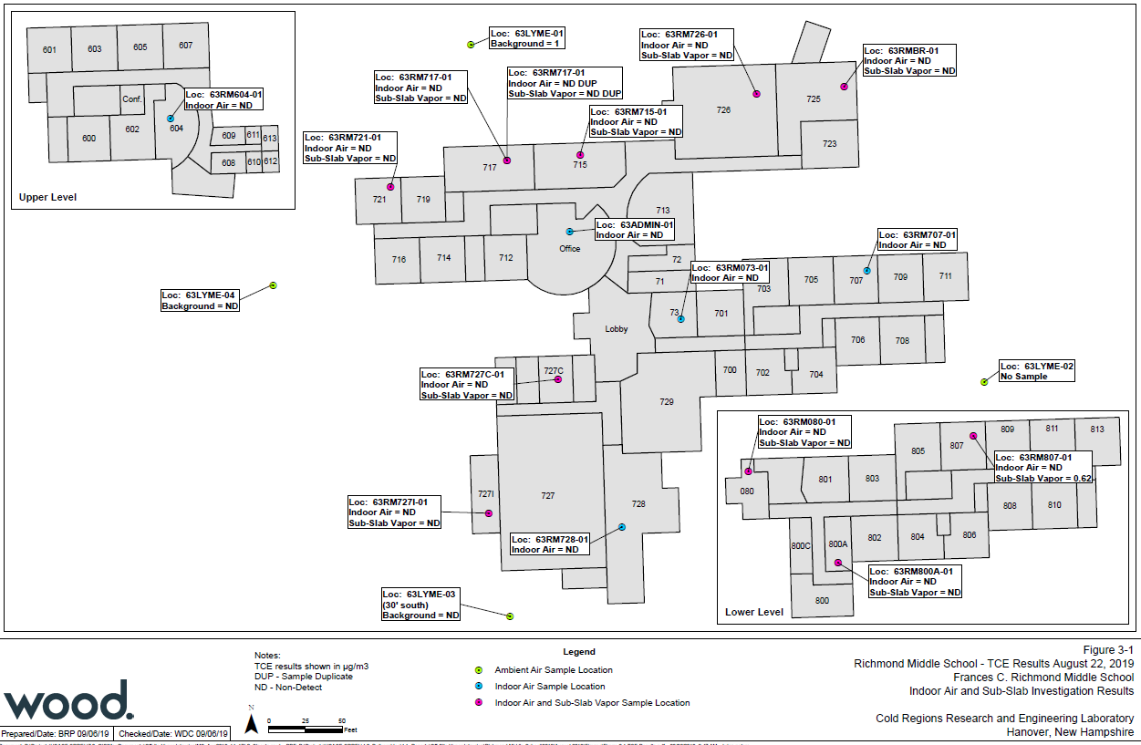
Richmond Middle School Indoor Air Sampling
Attended SAU70 School Board May 2018 Meeting
Sample December 2018
Sample in August and December 2019 (bi-annual)
Sample August 2020
Cease Monitoring following August 2020 sampling event
RMS will be evaluated as part of the 5-Year Review Cycle

Slide 5
Richmond Middle School Indoor Air Sampling
Each sample non-detect for TCE save for one low level detection in a sub-slab sample
Next Sampling August 2020
Cease Monitoring following August 2020 sampling event
RMS will be evaluated as part of the 5-Year Review Cycle

Slide 6
Norwich Groundwater Sampling
Evaluated possible groundwater wells within a 1,500 foot search radius of TCE contamination below the Connecticut River
Found 2 wells that did not exist in the 1990’s
One bedrock well and a dug well (shallow overburden).
Both wells were non-detect for TCE.

Slide 7
Feasibility Study
Formal comments from USACE are being addressed
Groundwater cleanup is the key issue
Additional groundwater modeling has been performed to support remedy evaluation
Report is being revised to allow more flexibility during long-term site management

Slide 8
Future Work
Continue to monitor rebound concentrations at AOC 2 and AOC 9.
Enhanced Permeability Pilot Testing Fall 2019
Finalize Feasibility Study

Slide 9
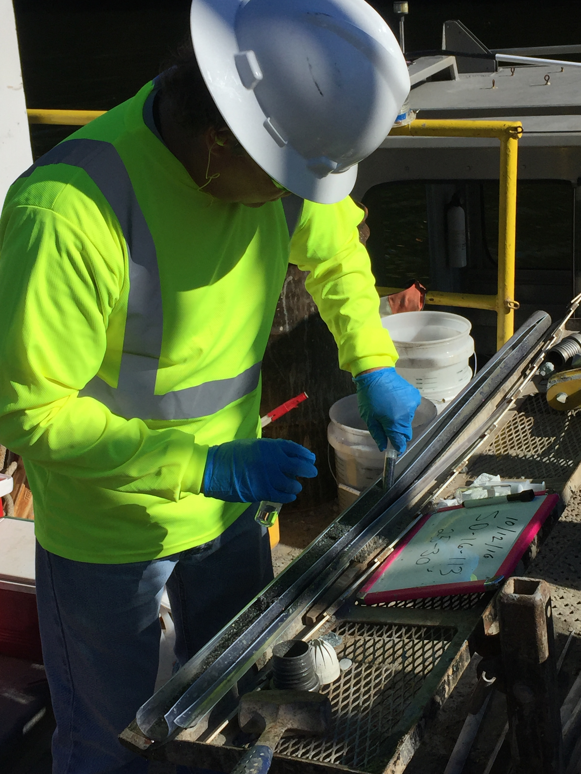
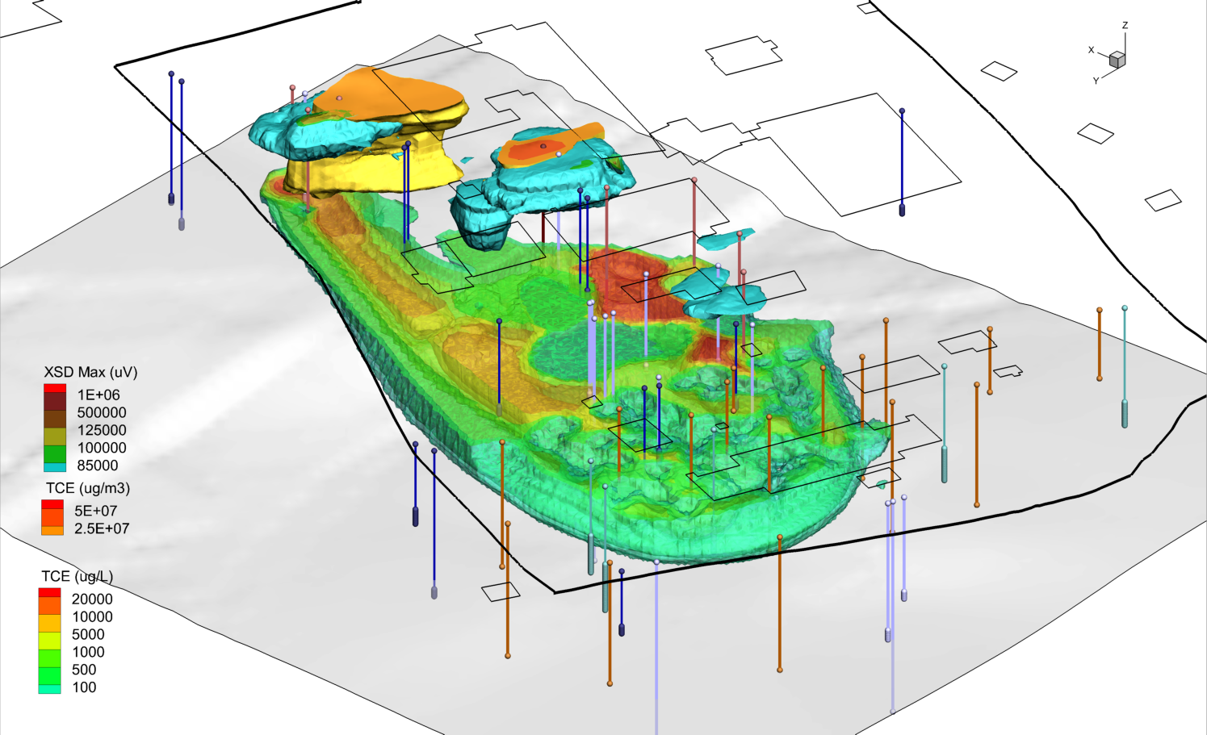
Thank You
Questions or Comments

